Slide 1
Requirements Elicitation Techniques and Analysis Modeling

Slide 2
Requirements Elicitation
Requirements elicitation is the process of gathering and understanding the needs and expectations of stakeholders to define the scope of a project or system. It is a crucial phase in the software development life cycle and can significantly impact the success of a project. There are various techniques used for requirements elicitation, and different situations may call for different approaches. Here are some common requirements elicitation techniques:

Slide 3
Interviews
One-on-one or group discussions with stakeholders to understand their perspectives, concerns, and requirements. Interviews allow for in-depth exploration of ideas and can be tailored to specific individuals or groups.

Slide 4
Surveys and Questionnaires
Distributed electronically or on paper to collect information from a large number of stakeholders. Surveys help gather data efficiently, especially when it's not feasible to conduct individual interviews with every stakeholder.

Slide 5
Workshops and Focus Groups
Interactive sessions involving multiple stakeholders facilitated by a moderator. Workshops and focus groups encourage collaboration, creativity, and knowledge sharing among participants.

Slide 6
Document Analysis
Reviewing existing documentation such as reports, manuals, and other relevant materials to extract requirements and insights. This technique is especially useful when dealing with an existing system or domain.

Slide 7
Observation
Directly observing users or stakeholders while they perform their tasks in their natural environment. Observation helps to identify implicit requirements and understand user behavior better.

Slide 8
Prototyping
Building a basic version of the system or product to allow stakeholders to interact with it and provide feedback. Prototyping is particularly useful for clarifying requirements and validating design decisions.

Slide 9
Use Case Analysis
Analyzing scenarios that describe interactions between users and the system to identify functional requirements. Use cases help to understand how the system should behave in different situations.

Slide 10
Brainstorming
A group technique that encourages stakeholders to generate new ideas and requirements collaboratively. Brainstorming fosters creativity and can uncover innovative solutions.

Slide 11
Domain Modeling
Building a conceptual model of the problem domain to identify key concepts, relationships, and rules.

Slide 12
Analysis Modeling
Chapter 8 - Software Engineering: A Practitioner’s Approach, 6/e

Slide 13
Requirements analysis
Requirements analysis allows the software engineer to:
elaborate on basic requirements established during earlier requirement engineering tasks
build models that depict user scenarios, functional activities, objects and their relationships, system behavior, and the flow of data as it is transformed.

Slide 15
Elements of Analysis Modeling
Data Dictionary: Data dictionaries are lists of all the names used in the system models; description of the entities, their attributes and relationships are included.
Data Flow Diagram: Data flow diagram model the data processing of the system.
State Transition Diagram: It represents the dynamic model, which shows changes in the state that an object goes through during its lifetime in response to an event.
Entity Relationship Diagram: It consists of information required for each entity or data objects and shows a relationship between objects. It shows the structure of the data in table format.

Slide 16
Data Modeling
examines data objects independently of processing
focuses attention on the data domain
creates a model at the customer’s level of abstraction
indicates how data objects relate to one another

Slide 17
What is a Data Object?
Object
—something that is described by a set
of attributes (data items) and that will be
manipulated within the software (system)
object: Student
attributes:
roll_Num
Name
Type
Marks
Address
each
instance
of an object (e.g., a book)
can be identified uniquely (e.g., ISBN #)
each plays a necessary role in the system
i.e., the system could not function without
access to instances of the object
each is described by attributes that are
themselves data items

Slide 18
What is a Relationship?
relationship
—indicates “connectedness”;
a "fact" that must be "remembered“by the system
and cannot or is not computed or derived mechanically
several instances of a relationship can exist
objects can be related in many different ways

Slide 19
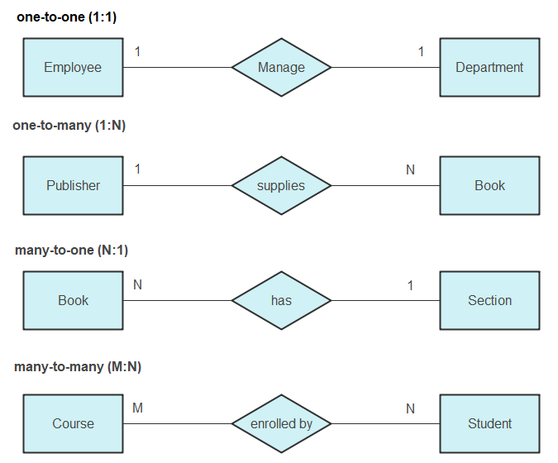
ERD Notation

Slide 20
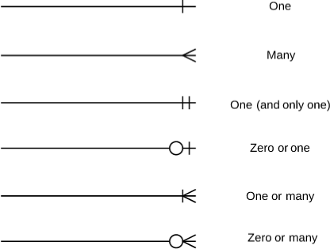
ERD Notation

Slide 21
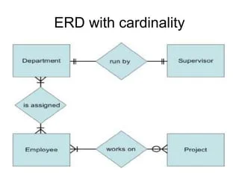
The ERD: An Example

Slide 22
Flow-Oriented Modeling
Represents how data objects are transformed at they move through the system
Data flow diagram is graphical representation of flow of data in an information system. It is capable of depicting incoming data flow, outgoing data flow and stored data.
computer
based
system
input
output

Slide 23
Flow Modeling Notation
external entity
process
data flow
data store

Slide 24
External Entity
A producer or consumer of data
Examples: a person, a device, a sensor
Another example: computer-based
system
Data must always originate somewhere
and must always be sent to something

Slide 25
Process
A data transformer (changes input
to output)
Examples: compute taxes, determine area,
format report, display graph
Data must always be processed in some
way to achieve system function

Slide 26
Data Flow
Data flows through a system, beginning
as input and be transformed into output.
base
compute
triangle
area
area
height

Slide 27
Data Stores
Data is often stored for later use.
sensor #
sensor #, type,
location, age
look-up
sensor
data
report required
type,
location, age
sensor number
sensor data

Slide 28
Data Flow Diagramming: Guidelines
all icons must be labeled with meaningful names
the DFD evolves through a number of levels of detail
always begin with a context level diagram (also called level 0)
always label data flow arrows
do not represent procedural logic

Slide 29
Constructing a DFD—I
review the data model to isolate data objects and use a grammatical parse to determine “operations”
determine external entities (producers and consumers of data)
create a level 0 DFD

Slide 30
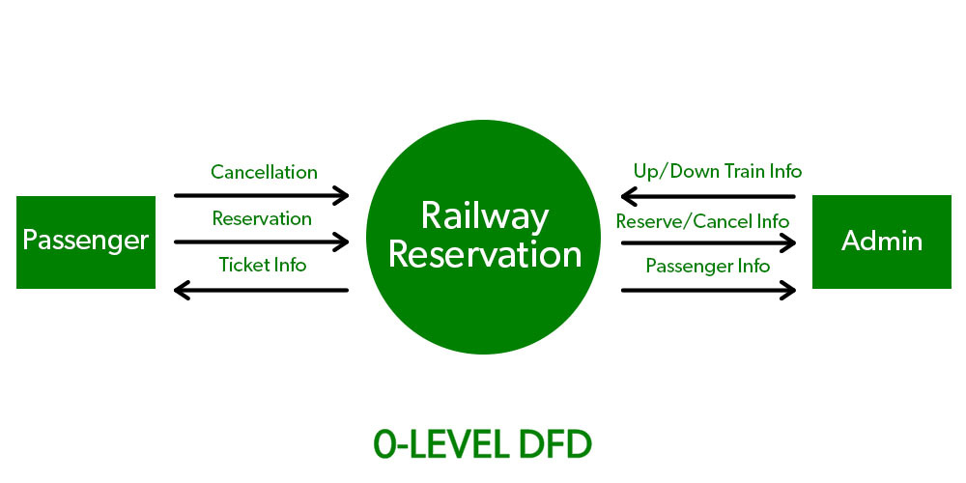
Level 0 DFD Example

Slide 31
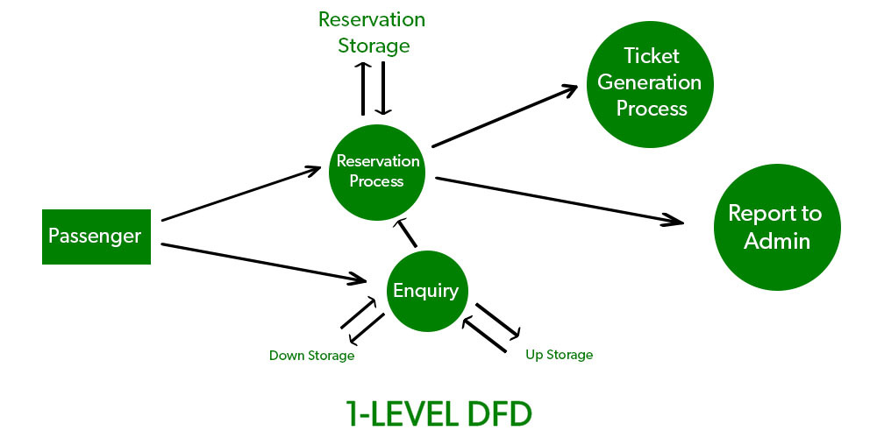
Level 1 DFD

Slide 32
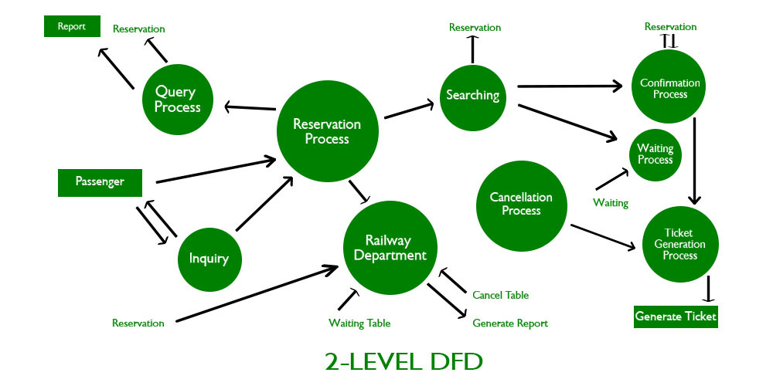
Level 2 DFD

Slide 33
The Data Flow Hierarchy
a
b
x
P
y
level 0
a
c
p2
f
p1
p4
b
d
5
p3
e
g
level 1
Any correspondence with a use case diagram?

Slide 34
Behavioral Modeling
The behavioral model indicates how software will respond to external events or stimuli. To create the model, the analyst must perform the following steps:
Evaluate all use-cases to fully understand the sequence of interaction within the system.
Identify events that drive the interaction sequence and understand how these events relate to specific objects.
Create a sequence for each use-case.
Build a state diagram for the system.
Review the behavioral model to verify accuracy and consistency.

Slide 35
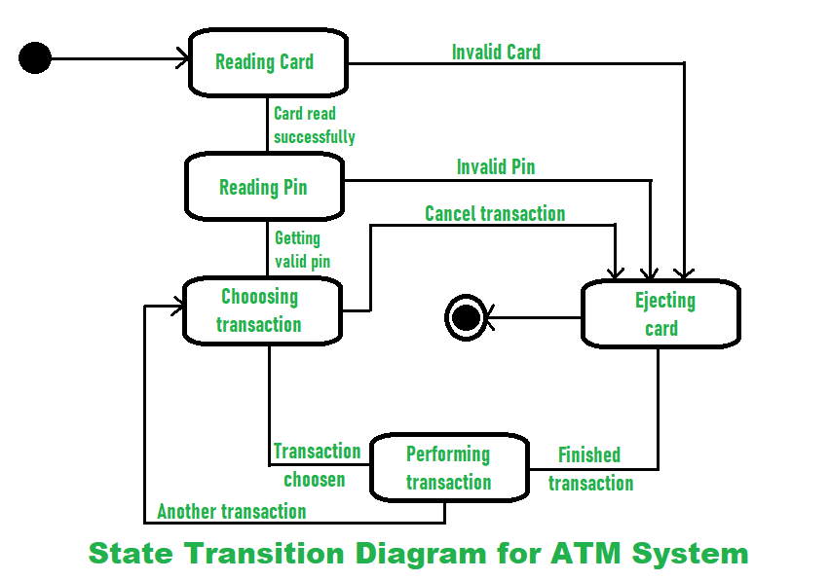
State Diagram for the ATM System

Slide 36
The States of a System
state—a set of observable circum-stances that characterizes the behavior of a system at a given time
state transition—the movement from one state to another
event—an occurrence that causes the system to exhibit some predictable form of behavior
action—process that occurs as a consequence of making a transition

Slide 37
Behavioral Modeling
make a list of the different states of a system (How does the system behave?)
indicate how the system makes a transition from one state to another (How does the system change state?)
indicate event
indicate action
draw a state diagram or a sequence diagram

Slide 38
Sequence Diagram for Entrance
:User
:CarPark
:Sensor
:CardReader
:Valid card
:Barrier
:Full Sign
Full Sign off
Car present
Check space left
Yes
Card number
Card number
Card returned
Card OK
Raise
Car not present
lower
Decrement Space
Check space left
Yes

